Slide 1
Affairs: Why they Occur and Ways to Rebuild Trust
Crystal D’Orazio, LMFT, CSAC, CSIT
Sarah Maleck, LPC, LMFT
Mental Health and Substance Use Recovery Training Conference
Kalahari Resort, Wisconsin Dells October 30th, 2019

Slide 2
Crystal D'Orazio LMFT, CSAC, CSIT
Owner of Marriage & Family Solutions
Practicing for almost 15 years
Awarded top 3 best Marriage Therapists in Madison
Nominated for Athena award in 2016
Sarah Maleck, LPC, LMFT
Has taught classes at UW- Madison regarding coping with stress and couples relationships
PREPARE/ENRICH Certified
Practicing for 8 years

Slide 3
What is Infidelity?
The definition of infidelity is subjective and based on the expectations and definition of each partner in the relationship
Betrayal
Loss of Trust
Deception
Violation of Expectations

Slide 4
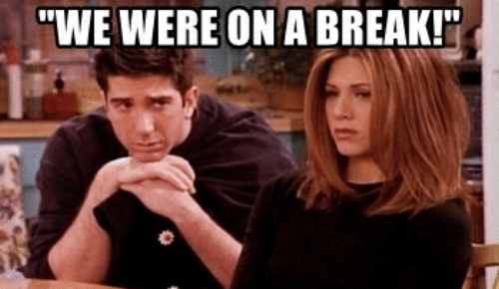

Slide 5
Why Do People Cheat?
Oftentimes when people cheat, it is because one or more of their needs are not being met in their relationship
Sexual Dissatisfaction
Feeling Unappreciated, Neglected, or Ignored
Seeking Emotional Validation
Feeling Lonely or Bored
Struggles with Aging and/or Body Image

Slide 6
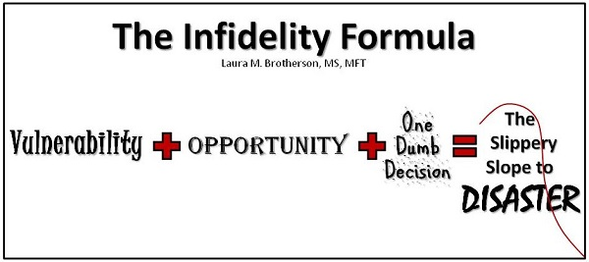

Slide 9
Red Flags
Partner becomes emotionally distant or inappropriately defensive
Sudden changes in energy/interests/hobbies
Increased attention to appearance
Extreme need for privacy
Unaccounted time
Changes in sex/affection
Lying

Slide 10
Which Differences Matter?
Active/Lazy
Hot/Cold
Optimist/Pessimist
Extrovert/Introvert
Male/Female
Black/White
Smart/Stupid
Physical/Sedentary
Practical/dreamy
Rich/Poor
Political views
Aggressive/Passive

Slide 11
"Is there a clearly formulated, passionately held difference between you that has to do with the shape, texture and quality of your life as you actually experience it?“
In other words, do we passionately disagree about our differences?
Too Good To Leave, Too Bad To Stay - pg. 176

Slide 12
Men vs. Women – What They Seek
Seek #1: Women Seek Soulmates; Men Seek Playmates
Women: "I finally found someone I can open up to“
Men: "my lover and I share so much - sex, tennis, jazz"
Seek #2: Women Believe Their Affair Is Justified When It's for Love; Men, When It's Not For Love
Seek #3: Women Anguish Over Their Affairs ; Men Enjoy Them
After the Affair- pg. 56-58

Slide 13
Sex Differences in Reactions to Affairs
Women and Men tend to respond differently to an affair
Evidence shows some gender-typical ways of reacting
**Note: These are only patterns, Don't over generalize,
isn't the case for everyone

Slide 14
Differences
Difference #1: Women Try to Preserve the Relationship; Men Turn and Run
Women: "Maybe we can work it out“
Men: "Don't bother to come back"
Difference #2: Women Get Depressed; Men Get Angry
Women: "I failed at the most significant relationship in my life“
Men: "If I run into my wife's lover, I'll kill him"
After the Affair- pg. 32-33

Slide 15
Differences, continued
Difference #3: Women Feel Inadequate as Companions; Men Feel Inadequate as Lovers
Women: "I'm not good enough a person. I can't satisfy my husband“
Men: "My penis is too small/big. I can't satisfy my wife"
Difference #4: Women Obsess; Men Distract Themselves
Women: "I can't stop thinking about his girlfriend“
Men: "I refuse to think about her affair"

Slide 16
Common (and conflicting) Reactions
Relief
Impatience
Chronic anxiety
Fear/Regret
Absence of guilt
Guilt over the children
Isolation
Hopelessness
Paralysis
Self-disgust
Notes:
Relief- I'm tired of lying
Impatience-I've left my lover and told you everything. What more do you want from me?
Chronic anxiety-As long as I keep busy, I'll be okay
Justified anger- I'm doing what I want to do, and it feels right
Absence of guilt-justified because of past anger
Guilt over the children- What kind of role model am I?
Isolation- Embarrassed and no one is there for me
Hopelessness- NO relationship will ever work
Paralysis - I don't know which way to go
Self-disgust

Slide 17
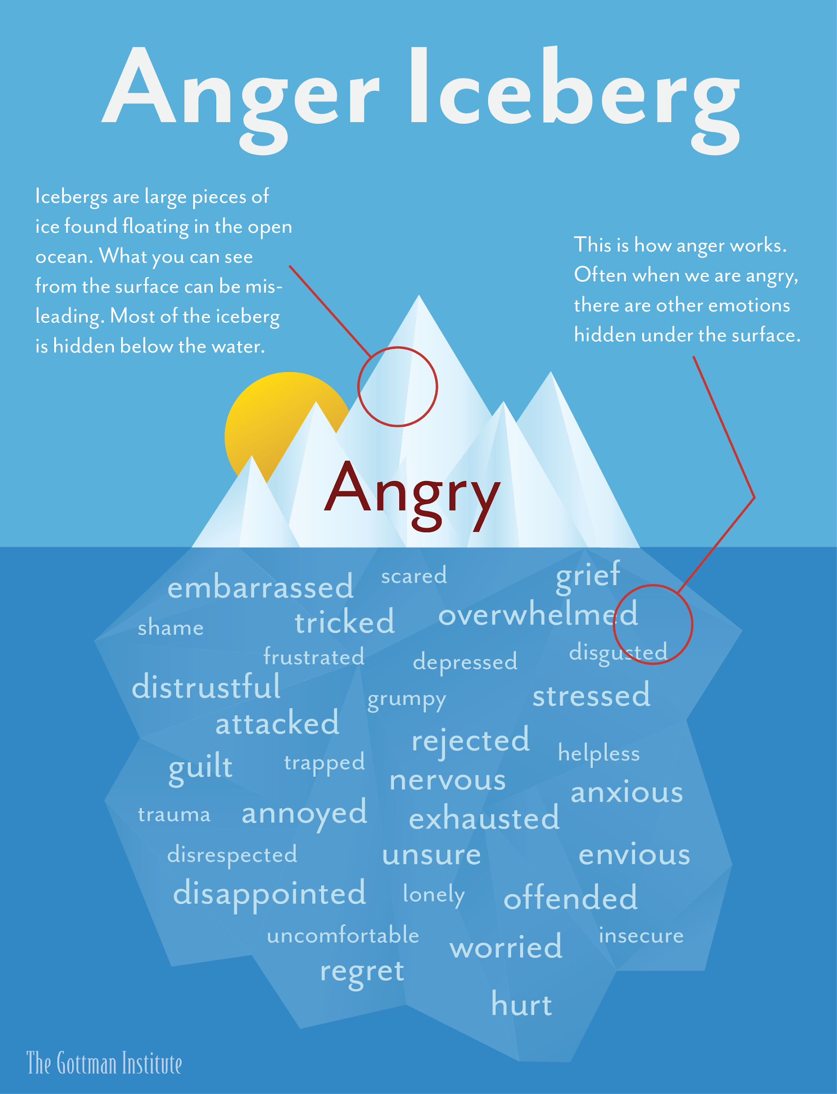

Slide 18
Should I Stay or Should I Go?
Common Thoughts
"Going back to my marriage feels like a prison sentence. But I can't abandon my kids"
"I wasn't looking to fall in love with someone else but I did. Now I can't decide which relationship to give up"
"I know I strayed, but I didn't mean to hurt you and I never stopped loving you. Can't we move on?”
Contradictions
Irresistibly drawn to your lover & disgusted with yourself
Bitterness toward your partner & remorse at the pain
After the Affair- pg. 37

Slide 19
What thoughts might go through your mind if you found out that _______ was having an affair?
-Your partner
-A Parent
-Best Friend
-Best Friend’s Partner
-Person you don’t get along with

Slide 20
Some Background on Working with Couples…

Slide 21
John Bowlby: Attachment Styles
Secure - feel comfortable with intimacy, and are usually warm and loving
Avoidant - equate intimacy with a loss of independence and constantly try to minimize closeness
Anxious - crave intimacy, often preoccupied with their relationships and tend to worry about their partner's ability to love them back
Disorganized- difficulty managing emotions and trusting partners

Slide 22
Gary Chapman: Five Love Languages
There are 5 different ways that we can give and receive love in relationships:
Physical Touch
Quality Time
Acts of Service
Words of Affirmation
Gifts

Slide 23
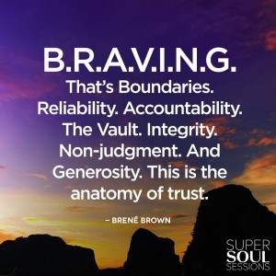
Brené Brown: Trust
Anatomy of Trust: "Choosing to make something important to you, vulnerable to the actions of someone else"

Slide 24
Trust, continued
Trust is like a marble jar
Built on small and insignificant moments
You can choose to build trust or choose to betray

Slide 25
John Gottman: Choosing Commitment
There needs to be a wall that separates you and your partner from the outside world, when you confide in another person about your relationship you open up a window
Window --> doorway = affairs
When you hide a friendship from your partner you create a wall between you and your partner

Slide 26
John Gottman, continued
You have to choose a commitment and stop whatever we are doing to answer to the bid for attention our partner is offering
Negative comparisons of our partner with real or imagined alternatives“
Rather than nurturing gratitude for what we have with our partner, we nurture resentment for what's missing“
In a committed relationship, you both stop the world to try to understand and ease each other's pain
Eight Dates- pg. 45

Slide 27
Recovering from an Affair

Slide 28
Other Types of Betrayal...
Conditional Commitment
Non-sexual affairs
Lying
Withdrawing (sexually or emotionally)
Disrespect
Physical or Emotional Abuse

Slide 29
Stages of Affair Recovery
Discovery
Grief
Acceptance
Recovery/Reconnection

Slide 30
Affair Recovery Using Emotion-Focused Therapy
Helping the injured partner describe their experience
Offending partner must understand and acknowledge their partner’s pain
Offending partner describes their own pain
Acknowledgement of shame and guilt
Describing what is needed during painful times
Describing what led to the affair

Slide 31
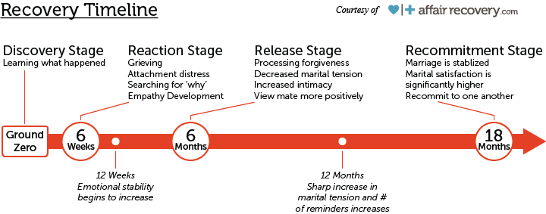
Sample Timeline

Slide 32
Personal Issues to Address
Dealing with regret/loss
Coping with guilt or fear of failure
Processing hurt and/or anger
Coming to terms with who you are & what you want for your life
Balancing time and energy

Slide 33
Increasing Communication and Conflict Resolution Skills

Slide 34
Evaluating and Expressing Expectations
"My partner and I should feel a deep, unspoken bond at all times“
"My partner should be able to anticipate my needs“
"I shouldn't have to work for love"
"I shouldn't have to work to be trusted“
After the Affair- pg. 72

Slide 35
Exploring Family of Origin Influences
We learn a lot about what relationships look like from our observations in our family of origin
What did communication in the home look like?
How was conflict handled?
What roles did each parent take on?
It is important to discuss the ways in which our families impact our view of relationships

Slide 36
Communication
Direct & Honest
Leave = Leave
Assumptions
Minimizing “Noise”-inserting unnecessary info, arguments, points or distractions
Volleyball- back and forth without resolution or accountability

Slide 37
Active Listening & Giving Feedback
“I-Statement”
“When _______, I felt _________
“The story I’m telling myself…”
Avoiding always/never
Knowing when to take a time-out

Slide 38
References
1. After the Affair - Janis Abrahms Spring
2. Too Good To Leave, Too Bad To Stay - Mira Kirshenbaum
3. Eight Dates - John & Julie Schwartz Gottman, Doug & Rachel Carlton Abrams
4. Brené Brown- Super Soul Podcast
5. "The Seven Types of Affairs" - affairadvice.com
6. Attached - Amir Levine & Rachel Heller
7. Infidelity Recovery Institute- www.infidelityrecoveryinstitute.com
8. Repairing Broken Bonds – Light Up the Couch Podcast
9. Laura Brotherson - strengtheningmarriage.com
10. Gary Chapman - www.5lovelanguages.com
11. Peggy & James Vaughan - Recovering from Affairs: Couples Handbook
12. Peggy Vaughan - The Monogamy Myth
13. Rick Reynolds - Affair Recovery
14. Esther Perel - TED2015 Rethinking Infidelity...a talk for anyone who has ever loved

Slide 39
Crystal D’Orazio, LMFT, CSAC, CSIT
Marriage and Family Solutions
www.marriagesolutionsmadison.com
marriage.solutions@sbcglobal.net
Sarah Maleck, LPC, LMFT
Maleck Therapy
www.malecktherapy.com
sarah.maleck@malecktherapy.com

Slide 40
“One rule of thumb which I have found helpful for myself is that, in any continuing relationship, any persistent feeling had better be expressed. Suppressing it can only damage the relationship…
If this is not done, what is unexpressed gradually poisons the relationship.”
-Carl Rogers

Slide 41
Helping Therapists Become
More Effective
Dealing with the affair directly
Explore the emotional impact
Don’t “blame” the hurt spouse
No secret keeping
Inform yourself about affairs and resources
Encourage honest communication and answering all questions.
Be aware of your own biases and beliefs

